Slide 1
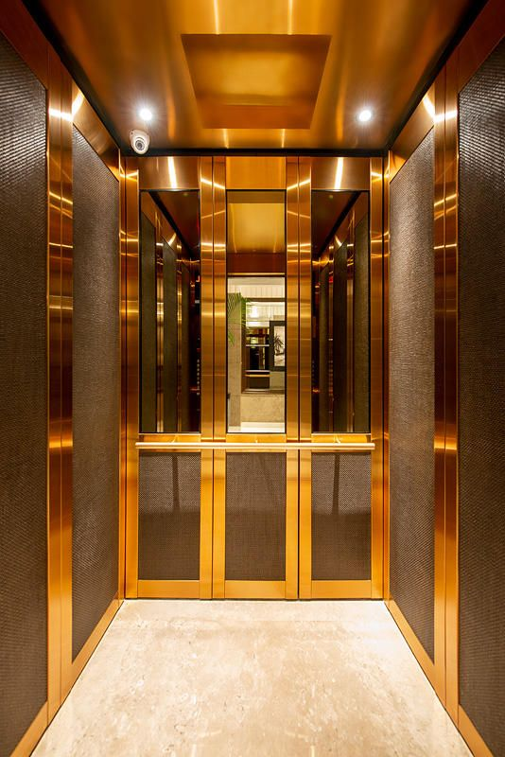
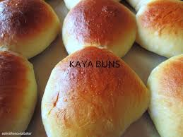
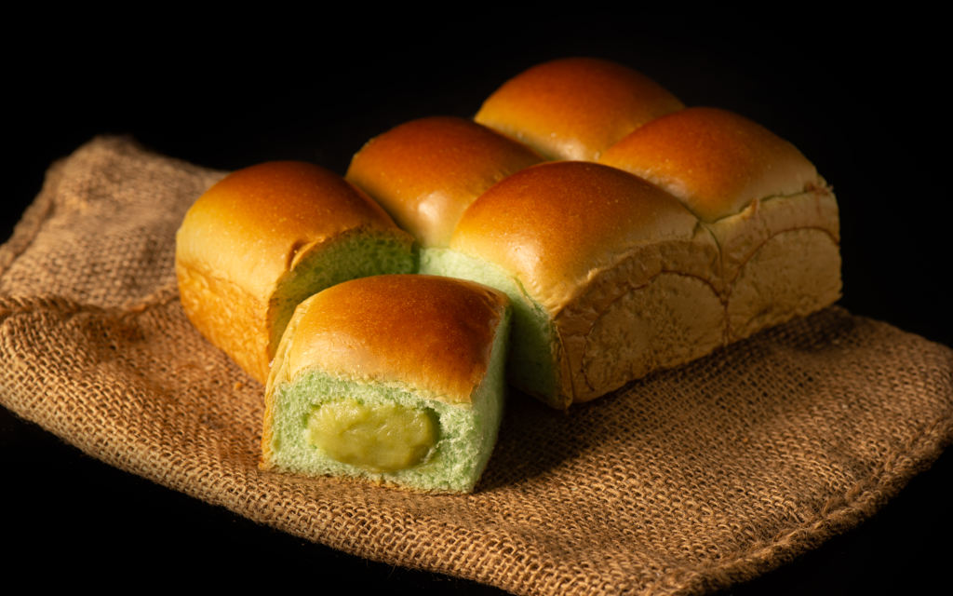
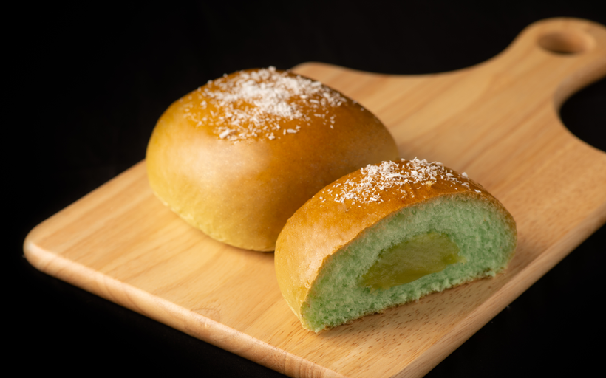
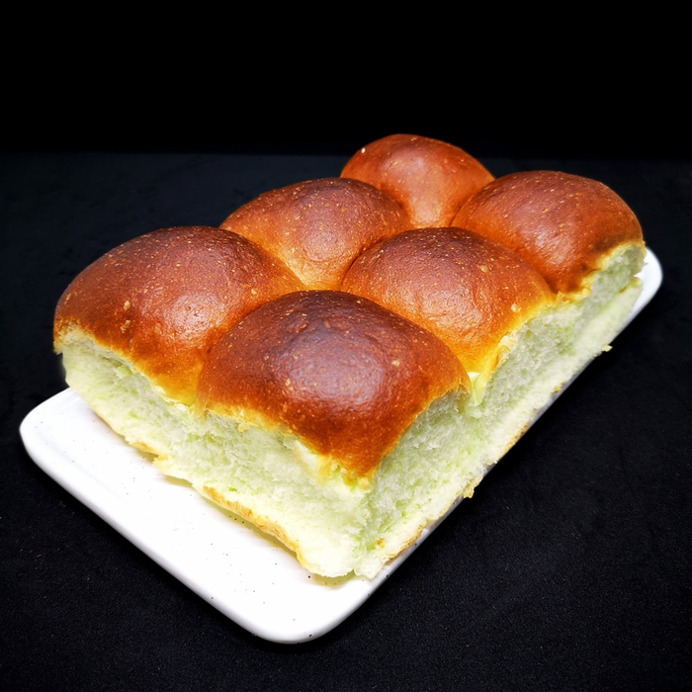
#TEAM
ELEVATED
Our values:
Just like how kaya spreads on the kaya bun, we believe in spreading our ideas and expertise.
Just like how the dough rises when we bake kaya buns, we are driven by aspirations to elevate the quality of existing services.
3.007 Design Thinking and Innovation
Group 1
Megan Chen Jia Yi
Gan Xiao Tong
Su Keming
Russell Teoh
Goh Jet Wei

